Slide 1

MAHATMA GANDHI INSTITUTE OF TECHNOLOGY(A)
DEPARTMENT OF INFORMATION TECHNOLOGY
An Industry Oriented Mini Project(IT653PC)
on
Smart Mechanic Finder
by
Thalla Akshaya – 22261A1258
Aeddu Pavan – 23265A1201
Batch ID : IT-25-07
Internal Supervisor
IOMP Coordinator
Dr. N. Sree Divya
Assistant Professor
IT department
Mrs. U. Chaitanya
Assistant Professor
IT department

Slide 2
cONTEXT
Abstract
Introduction
Existing System
Proposed System
Applications
Software Requirements
Hardware Requirements
Literature Survey
Objectives
Modules Description
Algorithm
Design – Architecture
UML Diagrams
Results
Test Cases
Conclusion
Future Enhancements
References

Slide 3
Abstract
Web platform to connect vehicle users with nearby mechanics.
AI-powered self-diagnosis using text input.
Real-time mechanic tracking and contact details.
Displays spare part cost and repair cost estimates.
SOS feature for emergency breakdown assistance.
Push notifications when mechanic accepts SOS requests.
Real-time chat with support for image sharing.
Enhances speed, transparency, and accessibility of roadside help.

Slide 4
Introduction
Unexpected vehicle breakdowns can be stressful, especially in areas with limited access to mechanics. Many drivers struggle to diagnose or fix minor issues, complicating roadside emergencies. Smart Mechanic Finder is a web platform that connects users with nearby mechanics in real time for quick assistance. It includes an AI-powered self-diagnosis tool where users describe issues or upload media for analysis. It suggests possible causes and fixes before contacting a mechanic.
Users can also locate auto shops for parts and view service ratings. For urgent breakdowns, the SOS feature alerts nearby mechanics for immediate response. Real-time tracking monitors the mechanic's approach. New features include push notifications when mechanics accept SOS requests and a dedicated chat space to exchange messages and images, enabling clear communication. The platform enhances accessibility, transparency, and convenience in roadside support.

Slide 5
Existing system
Manual Search: Users often rely on personal networks or online directories.
No Real-Time Tracking: Platforms lack real-time mechanic location data.
Lack of Cost Transparency: Repair costs are unpredictable.
Emergency Handling: There’s no integrated SOS system for breakdowns.
Limited Feedback Systems: Reviews are either absent or unreliable.

Slide 6
proposed system
Live Mechanic Tracking using geolocation.
Repair Cost Estimation using backend model.
Emergency SOS Feature for immediate roadside help.
AI Self-Diagnosis Tool to identify potential faults.
Ratings & Reviews to ensure quality services.
Push Notifications for mechanic response alerts.
Real-time Chat with media sharing for better issue explanation.

Slide 7
Limitations
Requires internet access.
Availability of mechanics may vary by region.
Accuracy of AI diagnosis may be limited by input quality.
Notification delivery may depend on mobile network.
Chat feature depends on both parties being online.

Slide 8
Advantages
Fast, real-time access to verified mechanics.
Reduces uncertainty during breakdowns.
AI helps identify issues without expert knowledge.
Transparent services via ratings and reviews.
Location-based SOS for immediate help.
Effective communication via chat and images.
Improves user confidence and trust.

Slide 9
applications
Private Car Owners – Fast access to help during breakdowns.
Transport Fleets – Monitor and assist multiple vehicles.
Rental Companies – Verify mechanic availability.
Workshops – Gain more visibility and service requests.
Travelers & Remote Drivers – Emergency support anywhere.

Slide 10
Software requirements
Html, CSS and Javascript
React JS
MongoDB
Visual studio Application
Postman Application
Web browser
Twilio

Slide 11
Hardware requirements
Processor: Intel i5 (10th Gen or higher)
RAM: Minimum 8GB
Storage: SSD with at least 256GB
GPU: NVIDIA GTX 1650 or higher

Slide 12
Literature survey
S.No | Author(s) & Year | Journal / Conference & Publisher | Methodology / Techniques Used | Merits | Demerits | Research Gaps
[1] | S. Valiollahi et al., 2024 | IEEE Access – IEEE | RTLS accuracy modeling and experimental evaluation | Strong real-world validation in industrial setups | Industrial-focused; not adapted for mobile vehicles | Application to dynamic vehicle environments missing
[2] | S. R. Kannan et al., 2023 | ICDSAAI 2023 – IEEE | IoT-enabled ML architecture for vehicle fault detection | Real-time monitoring with IoT; better predictive diagnostics | Performance depends on network/sensors | No discussion on UI/UX for end users
[3] | S. Alagarsamy et al., 2023 | ICSSIT 2023 – IEEE | Android-based smart garage system with embedded features | Simplified garage-user interaction via mobile interface | Limited to Android ecosystem; lacks AI/ML integration | No mechanic recommendation or intelligent diagnostics provided
[4] | W. Lang et al., 2022 | IEEE Transactions on Transportation Electrification – IEEE | Review of AI techniques (ML, DL, expert systems) for EV motor fault detection | Comprehensive survey of AI-based diagnostic methods for EV motors | Limited experimental validation; Focus mainly on EVs | Lack of integrated systems for hybrid vehicle fault detection
[5] | M. Al-Zeyadi et al., 2020 | IJCNN 2020 – IEEE | Deep learning-based intelligent fault diagnosis using CNN and ANN models | High accuracy and adaptability in diagnosing complex faults | High computational cost; Requires large datasets | Needs real-time deployment testing

Slide 13
Problem statement
Drivers face uncertainty during vehicle breakdowns due to unavailability of verified mechanics, cost estimation, and emergency support. There is no centralized, intelligent system to help users in such cases. Hence, there is a need for a smart web-based solution that provides real-time location tracking, repair estimation, AI-based diagnostics, chat-enabled communication, and SOS features to ensure reliability and safety.

Slide 14
objectives
Enable real-time mechanic tracking.
Estimate repair costs based on fault analysis.
Provide SOS help with exact location.
Allow review and rating system for transparency.
Enable AI-powered fault diagnosis by users.
Ensure secure user authentication and authorization.
Send push notifications for mechanic responses.
Enable real-time chat with image support.

Slide 15
Modules description
User Authentication Module – Registers drivers/mechanics and handles secure logins.
Mechanic Location Module – Uses geolocation and MongoDB’s 2dsphere queries to find nearby mechanics.
Repair Cost Estimator – Estimates cost for repairs using backend logic and ML models.
Review & Rating Module – Allows users to rate and review mechanics after service.
SOS Request Module – Sends location-based emergency requests to mechanics.
AI Fault Diagnosis – Asks questions to predict faults using Logistic Regression.
Chat & Media Module – Real-time messaging and image sharing between users and mechanics.
Notification System – Sends real-time mobile notifications when mechanics accept SOS requests.

Slide 16
Algorithm
Start
User logs in / registers
Detect user location (if driver)
Show nearby mechanics within 10km radius
Allow sending of SOS request or estimation
Mechanic receives request and updates status
Notify user and enable chat with mechanic
Save data and provide real-time updates
End

Slide 17
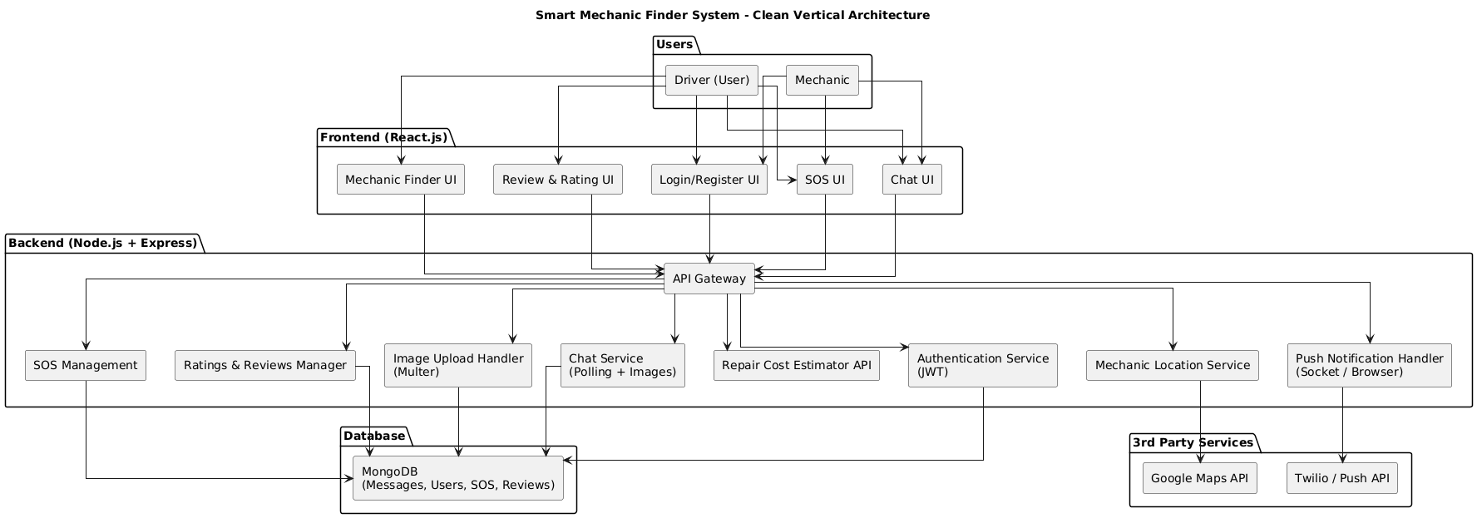

Design - architecture

Slide 18
Uml diagrams

Slide 19
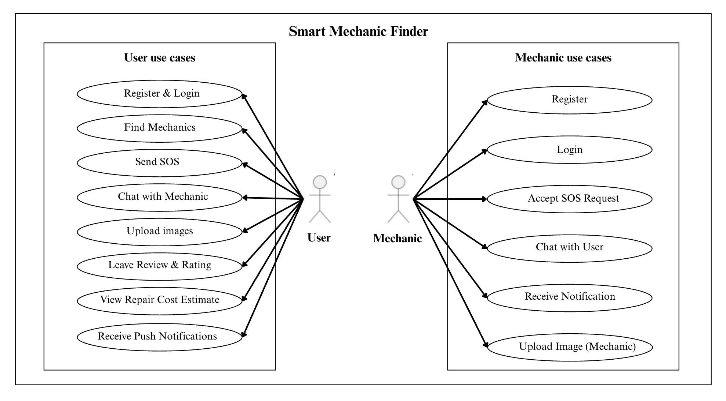
Use – case diagram

Slide 20
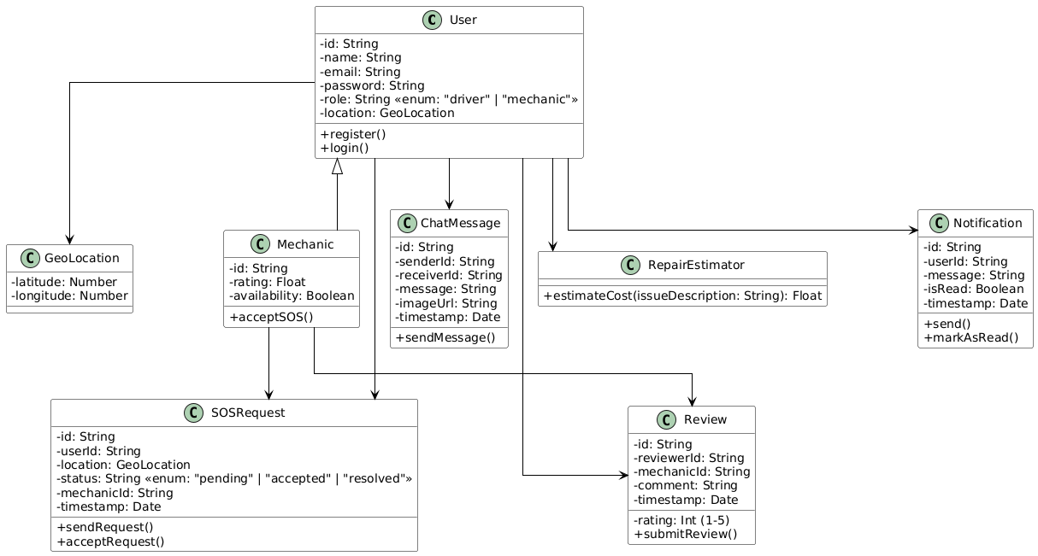
Class diagram

Slide 21
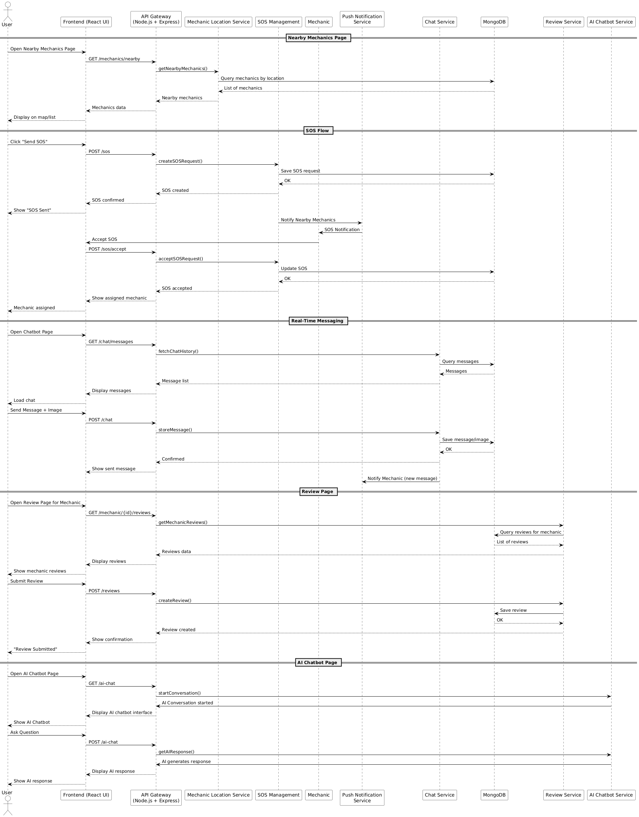
Sequence diagram

Slide 24
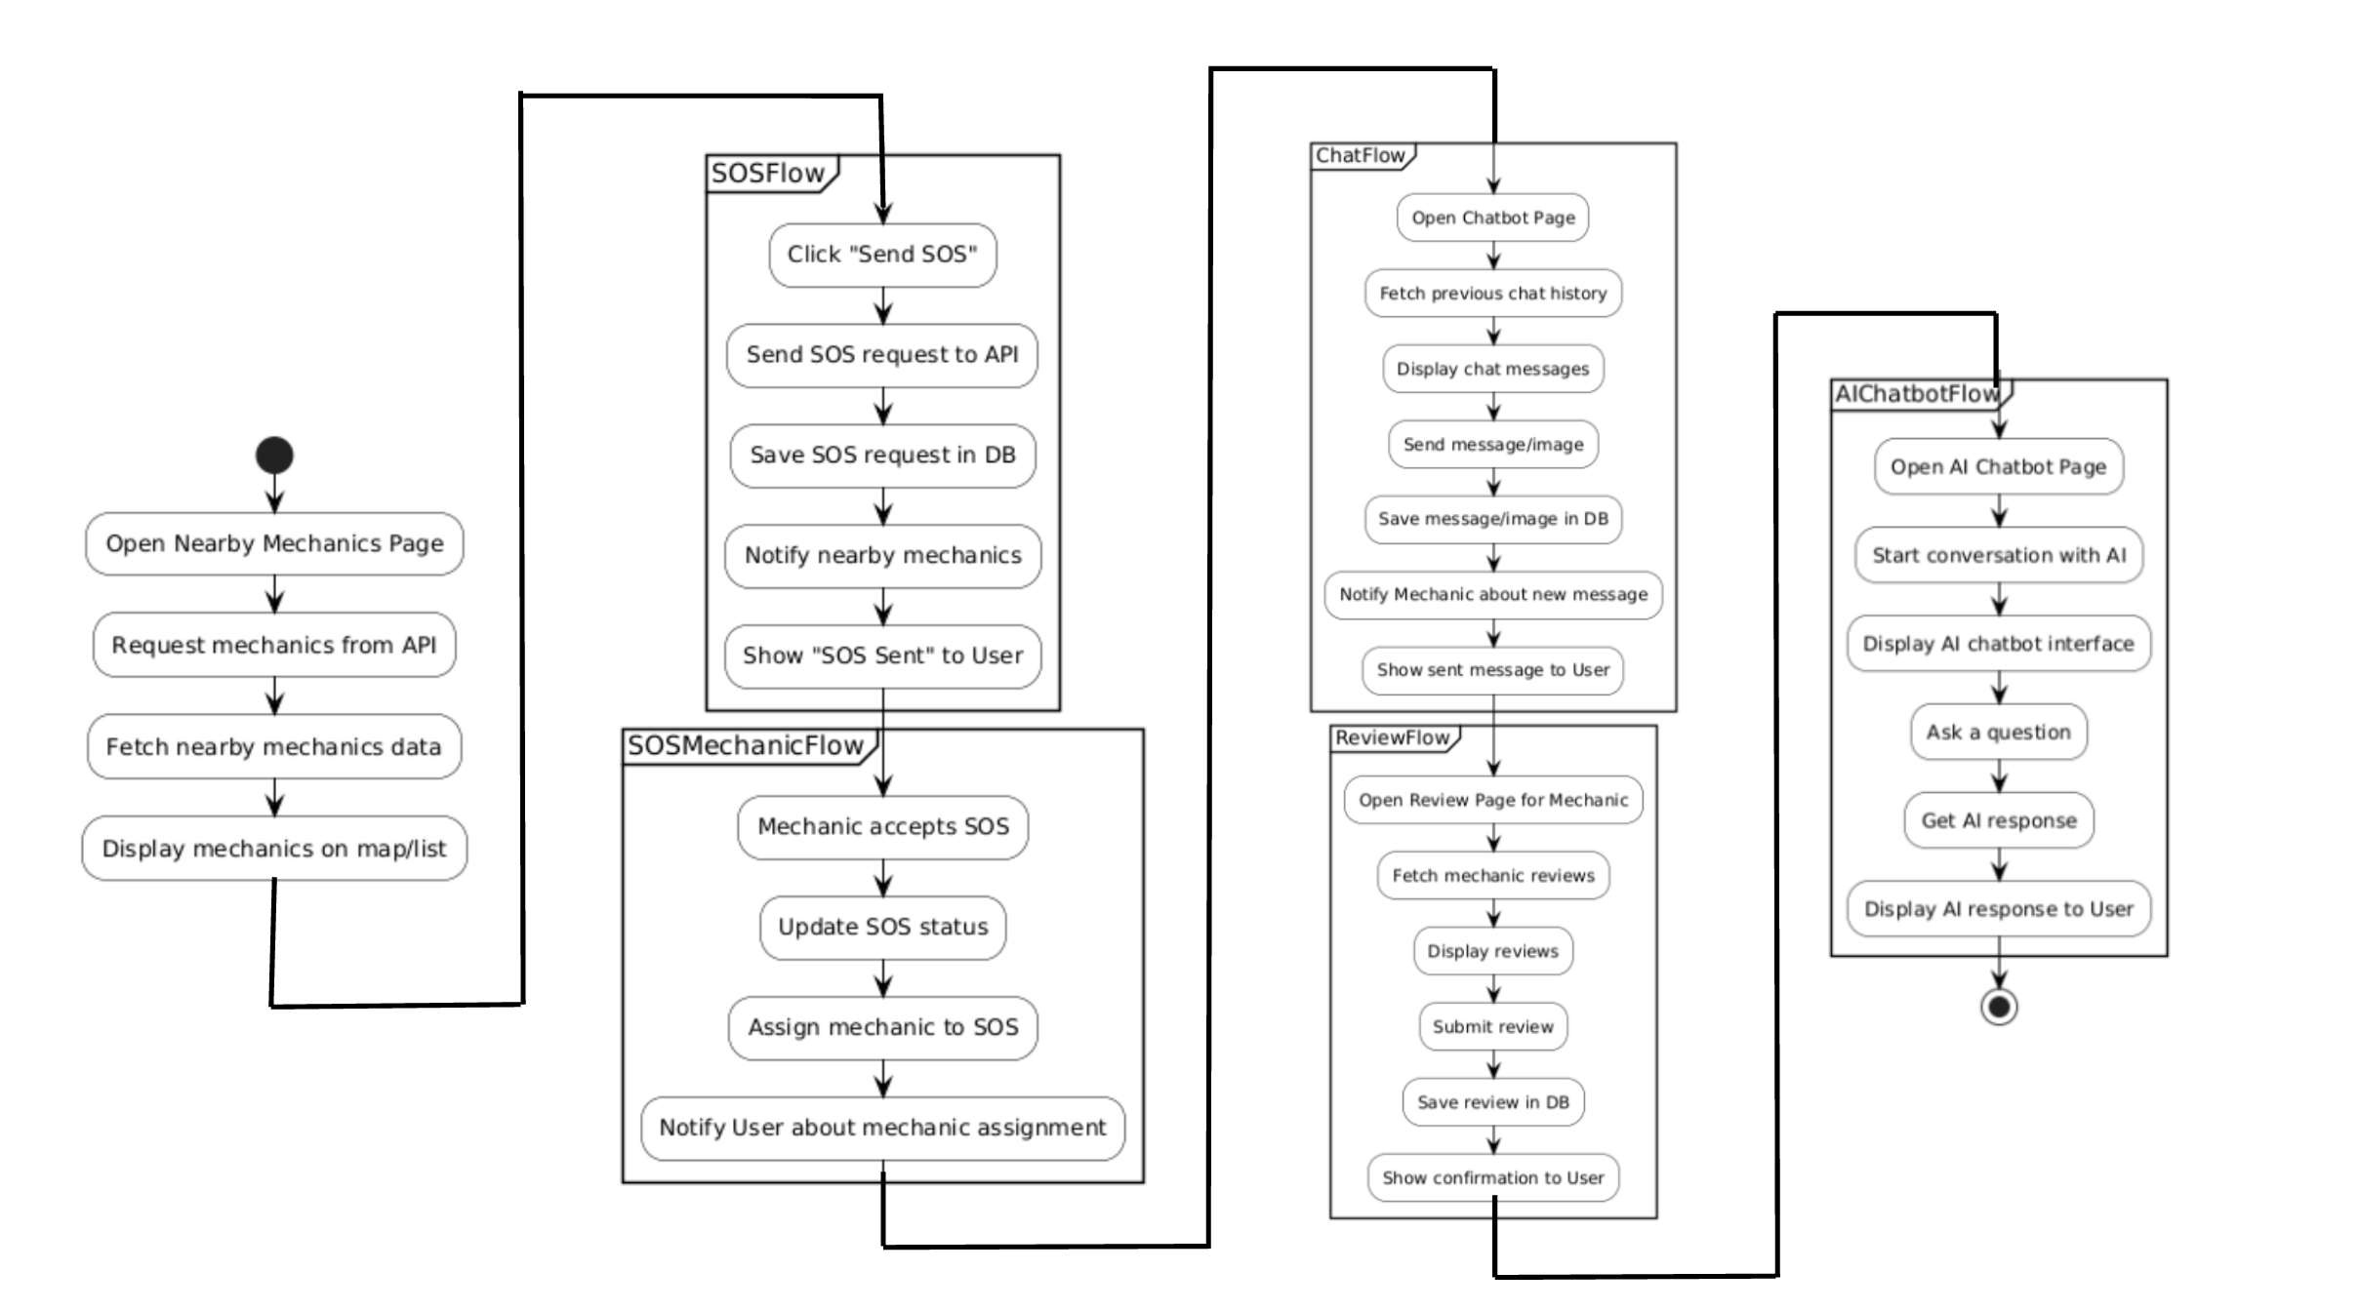
Activity diagram

Slide 25
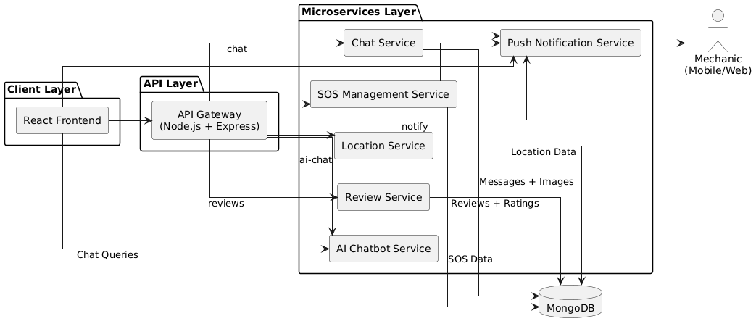
Component diagram

Slide 26
Test Cases

Slide 27
S.NO | Test Case Name | Input | Expected Output | Actual Output | Remarks
1 | New User Registration | Name, Email, Password | Redirects to login page after registration | Redirects to login page after registration | Pass
2 | Redirect after Login | Email and Password | Redirects to dashboard | Redirects to dashboard | Pass
3 | Clicking on Find Mechanics | Location | Redirects to find mechanics page and shows nearby mechanics | Redirects to find mechanics page and shows nearby mechanics | Pass
4 | Clicking on Send SOS | Location | shows confirmation | shows confirmation | Pass
5 | Mechanic Accepts SOS | Accept action from mechanic | User is notified and mechanic assigned | User is notified and mechanic assigned | Pass

Slide 28
S.NO | Test Case Name | Input | Expected Output | Actual Output | Remarks
6 | User Opens Chat with Mechanic | Name, Email, Password | Redirects to login page after registration | Redirects to login page after registration | Pass
7 | Redirect after Login | Click on chat with mechanic button | Redirects to chat page and loads chat interface | Redirects to chat page and loads chat interface | Pass
8 | Sending Text Message and images | Text + Image | Stores text and images and updates chat view | Stores text and images and updates chat view | Pass
9 | Rating a Mechanic | Rating + Review | Saves rating and updates average rating | Saves rating and updates average rating | Pass
10 | Logout Functionality | Click on logout button | Redirects to login page | Redirects to login page | Pass

Slide 29
Results

Slide 30
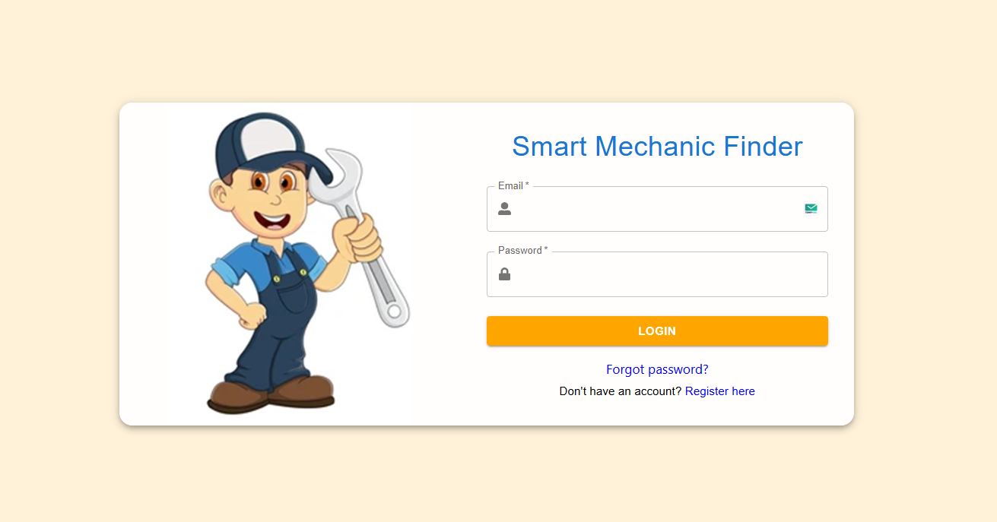
Login Page

Slide 31
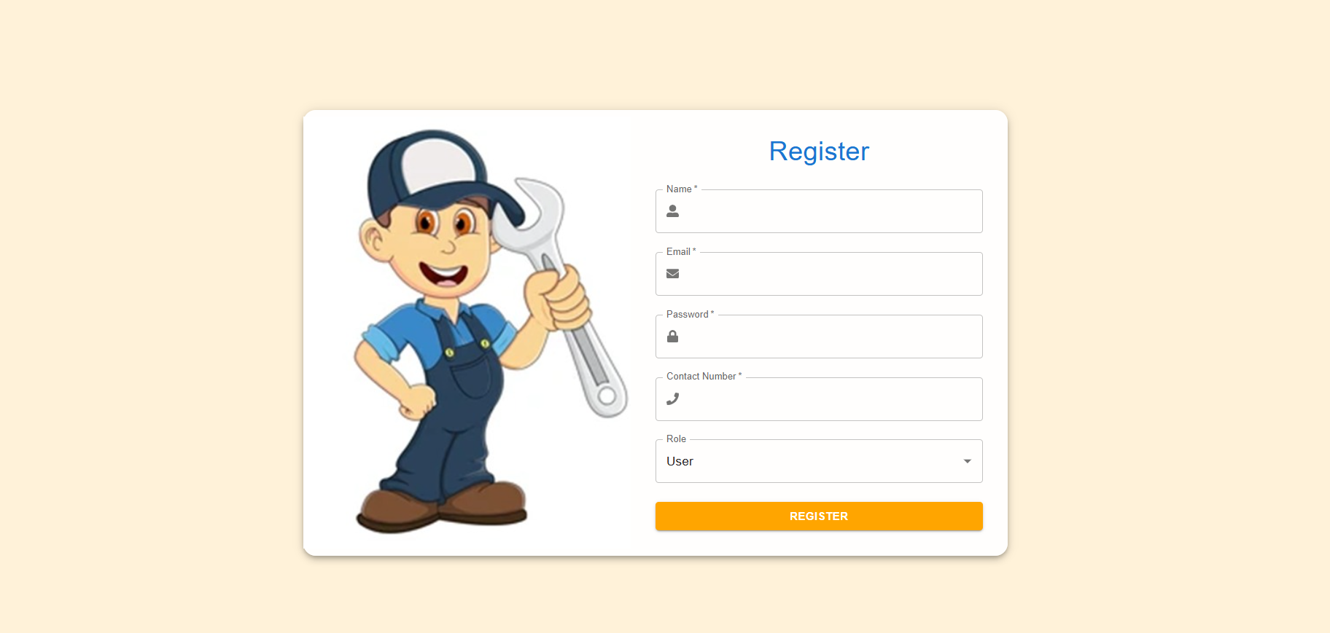
Registration Page

Slide 32
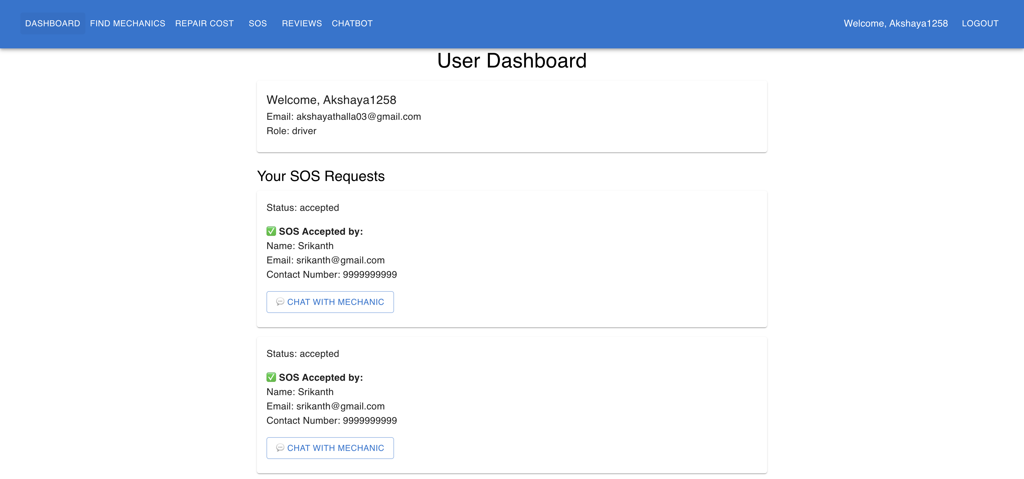
User Dashboard

Slide 33
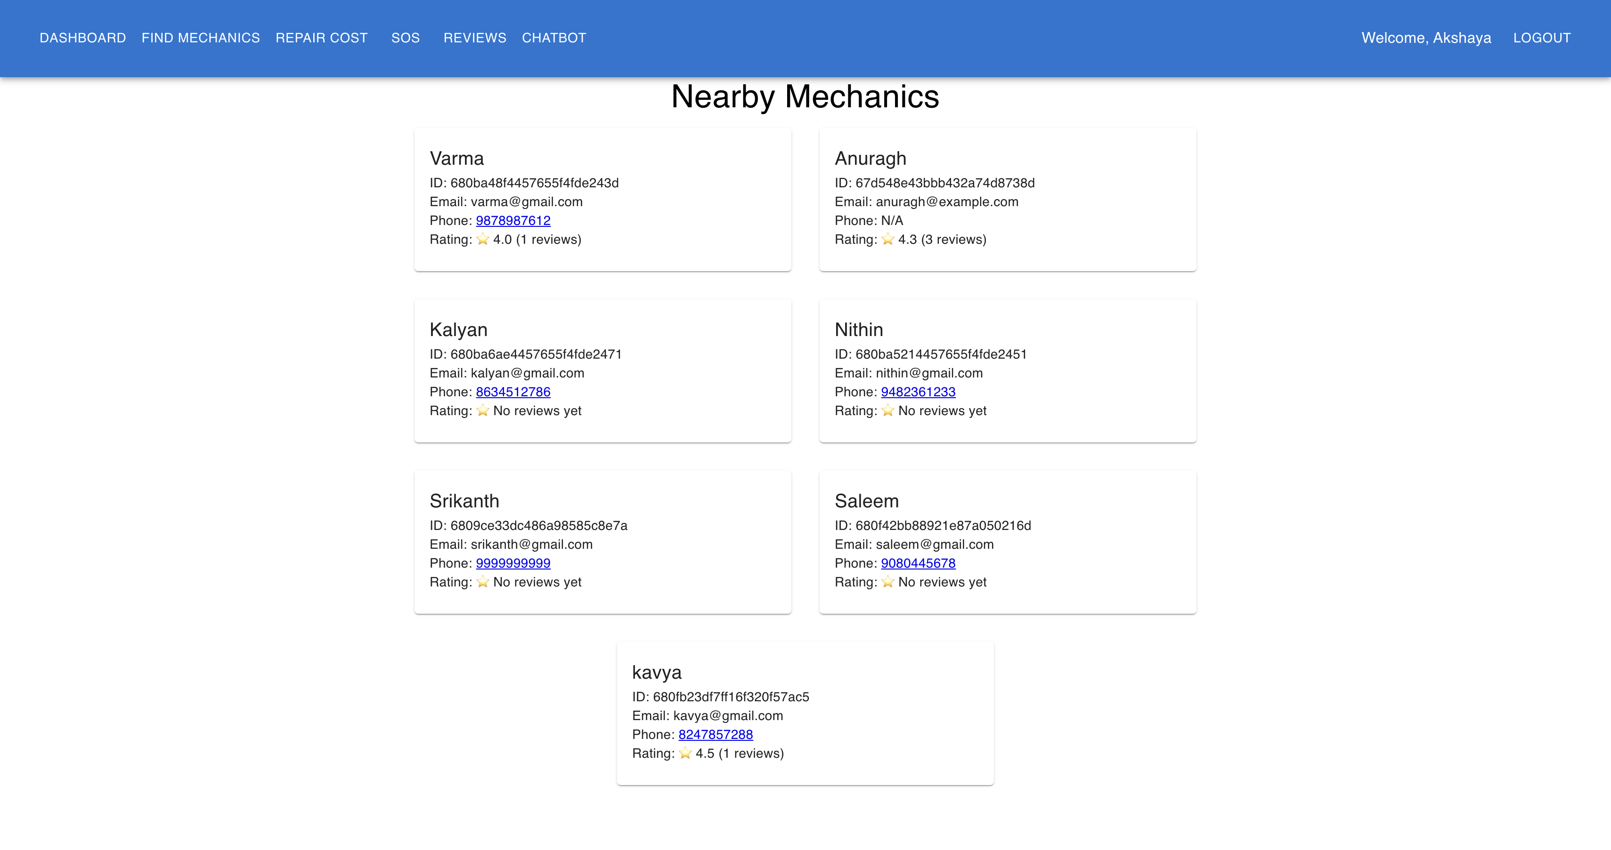
Near by Mechanics Page

Slide 34
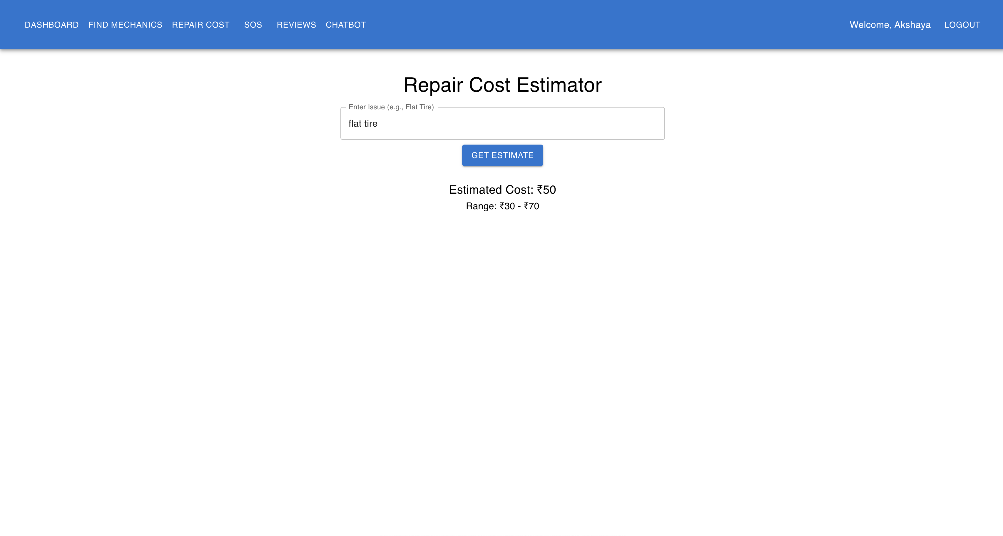
Repair Cost Estimator

Slide 35
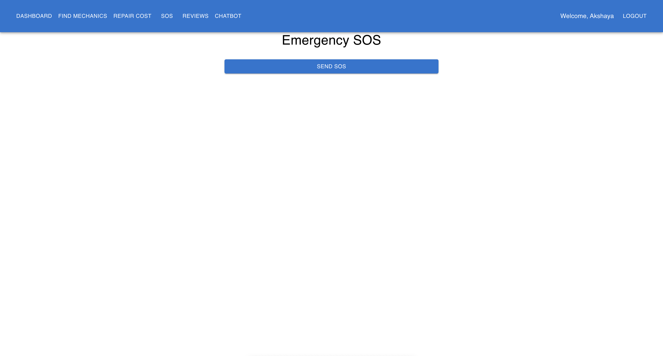
SOS Page

Slide 36
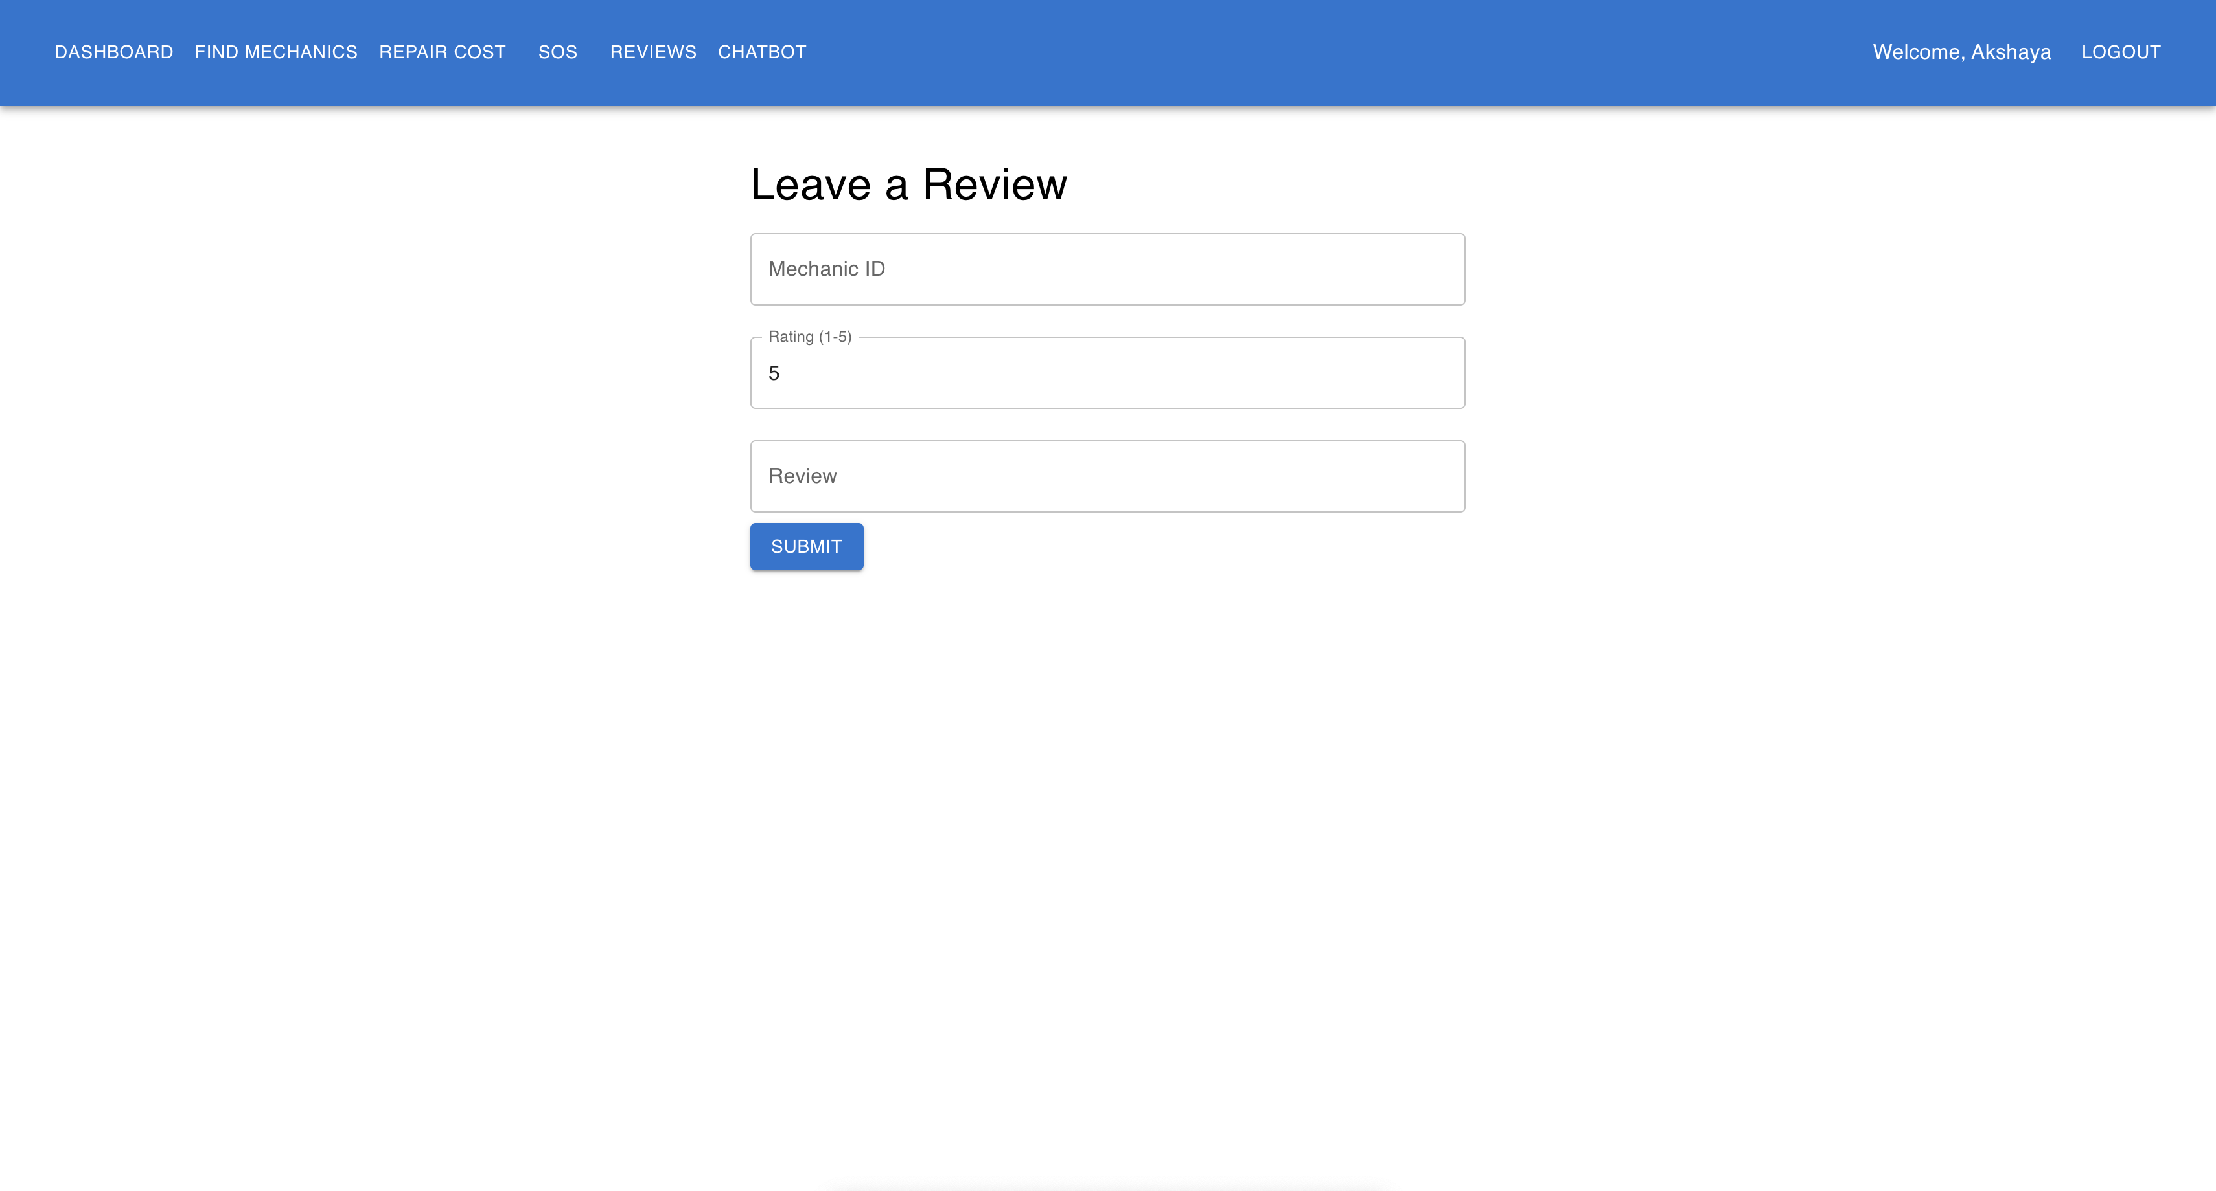
Rating & Reviews Page

Slide 37
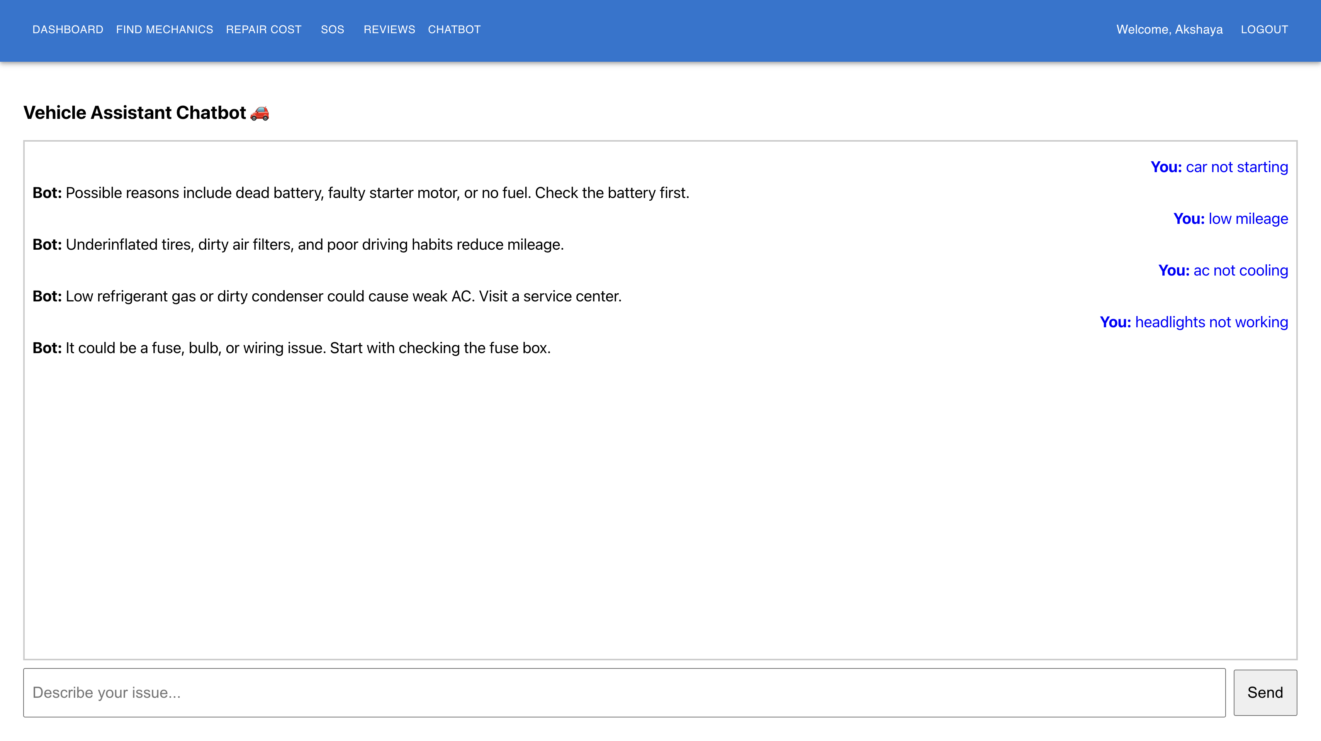
AI Chat bot

Slide 38
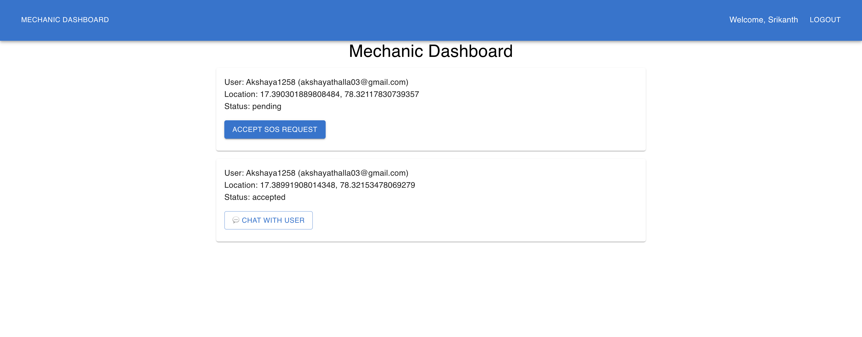
Mechanic Dashboard

Slide 39
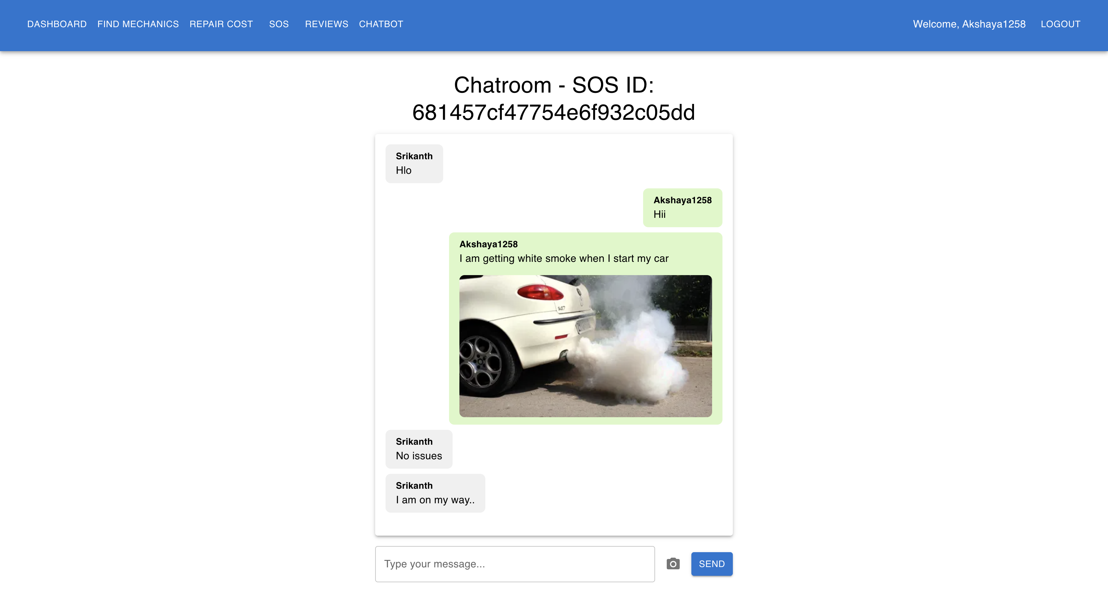
Chat Page for users and mechanics

Slide 40
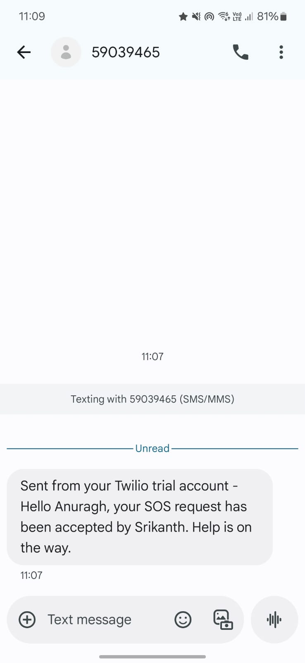
Push Notifications for Users
execution video

Slide 41
Future enhancement
Real-time Mechanic Tracking (like Uber driver live location).
Advanced AI Chatbot (GPT-4 based for smart troubleshooting help).
Mechanic Availability Toggle to show only online mechanics on the map.
In-App Payment System for secure transactions and billing.
Service History & Invoicing to track past repairs and download receipts.
Admin Dashboard for managing users, mechanics, and analytics.
Voice-Based SOS & Chat to improve accessibility and ease of use.

Slide 42
conclusion
This Smart Mechanic Finder project offers a complete solution for vehicle users to quickly locate nearby mechanics, estimate repair costs, request emergency SOS help, and even troubleshoot minor issues through a chatbot. By combining real-time location services, a review system, and a repair cost estimator, it greatly enhances the convenience and safety of drivers. Future enhancements like real-time tracking, integrated payments, and AI-driven support will further elevate the user experience, making this platform an essential tool for modern vehicle owners.

Slide 43
References
[1]. S. Valiollahi, I. Rodriguez, W. Zhang, H. Sharma and P. Mogensen, "Experimental Evaluation and Modeling of the Accuracy of Real-Time Locating Systems for Industrial Use," in IEEE Access, vol. 12, pp. 75366-75383, 2024, doi: 10.1109/ACCESS.2024.3405393
[2]. S. R. Kannan, P. Partheeban, R. Ramesh, P. N. Elamparithi, K. Somasundaram and R. Selvi, "Machine Learning and Vehicle Fault Diagnosis System with IoT Enabled Data," 2023 International Conference on Data Science, Agents & Artificial Intelligence (ICDSAAI), Chennai, India, 2023, pp. 1-9, doi: 10.1109/ ICDSAAI59313.2023.10452446.
[3]. S. Alagarsamy, B. Deepak, S. M. Asif, V. M. Krishna, C. Tejesh and A. S. Kumar, "Android based Smart System for Vehicle Garage," 2023 5th International Conference on Smart Systems and Inventive Technology (ICSSIT), Tirunelveli, India, 2023, pp. 450–454.
[4]. W. Lang, Y. Hu, C. Gong, X. Zhang, H. Xu and J. Deng, "Artificial Intelligence-Based Technique for Fault Detection and Diagnosis of EV Motors: A Review," in IEEE Transactions on Transportation Electrification, vol. 8, no. 1, pp. 384-406, March 2022, doi: 10.1109/ TTE.2021.3110318.
[5]. M. Al-Zeyadi et al., "Deep Learning Towards Intelligent Vehicle Fault Diagnosis," 2020 International Joint Conference on Neural Networks (IJCNN), Glasgow, UK, 2020, pp. 1-7, doi: 10.1109/ IJCNN48605.2020.9206972.

